Slide 1
Hack Devpost - The hackathon
Judging Details
Displays the details of the hackathon project assessment based on the judging criteria
Zohan Fachrullwahab - HackDevpost

Slide 2
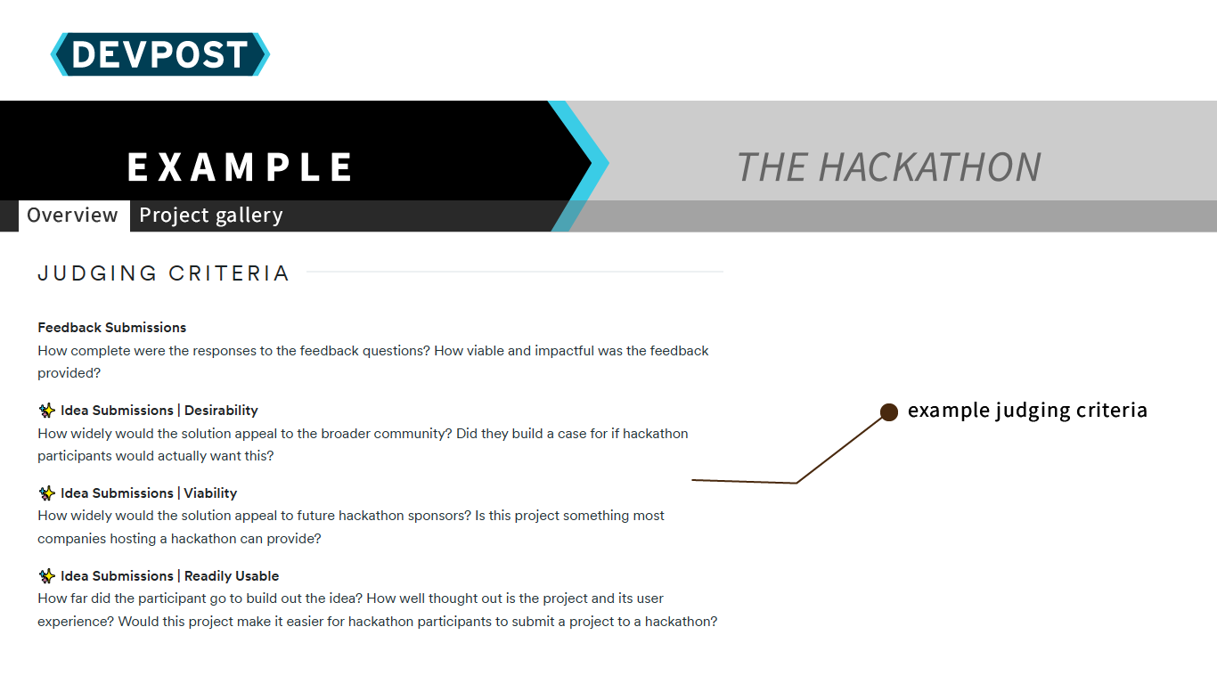
layout 1

Slide 3
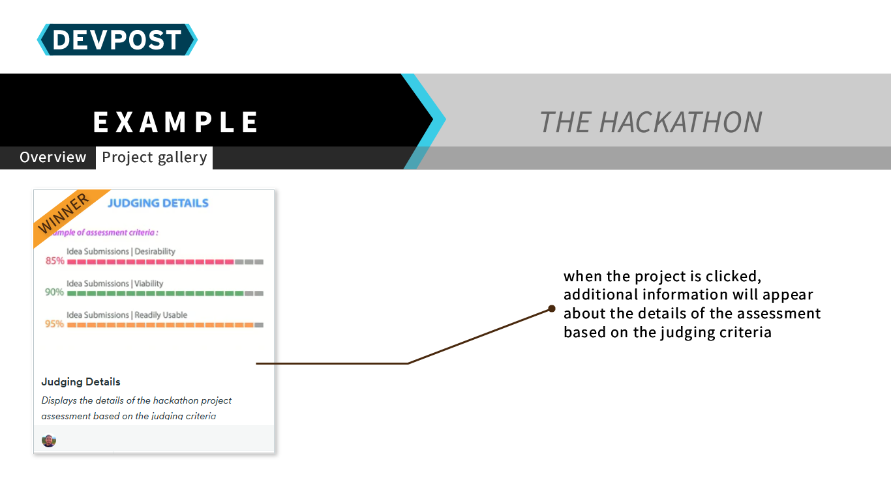
layout 2

Slide 4
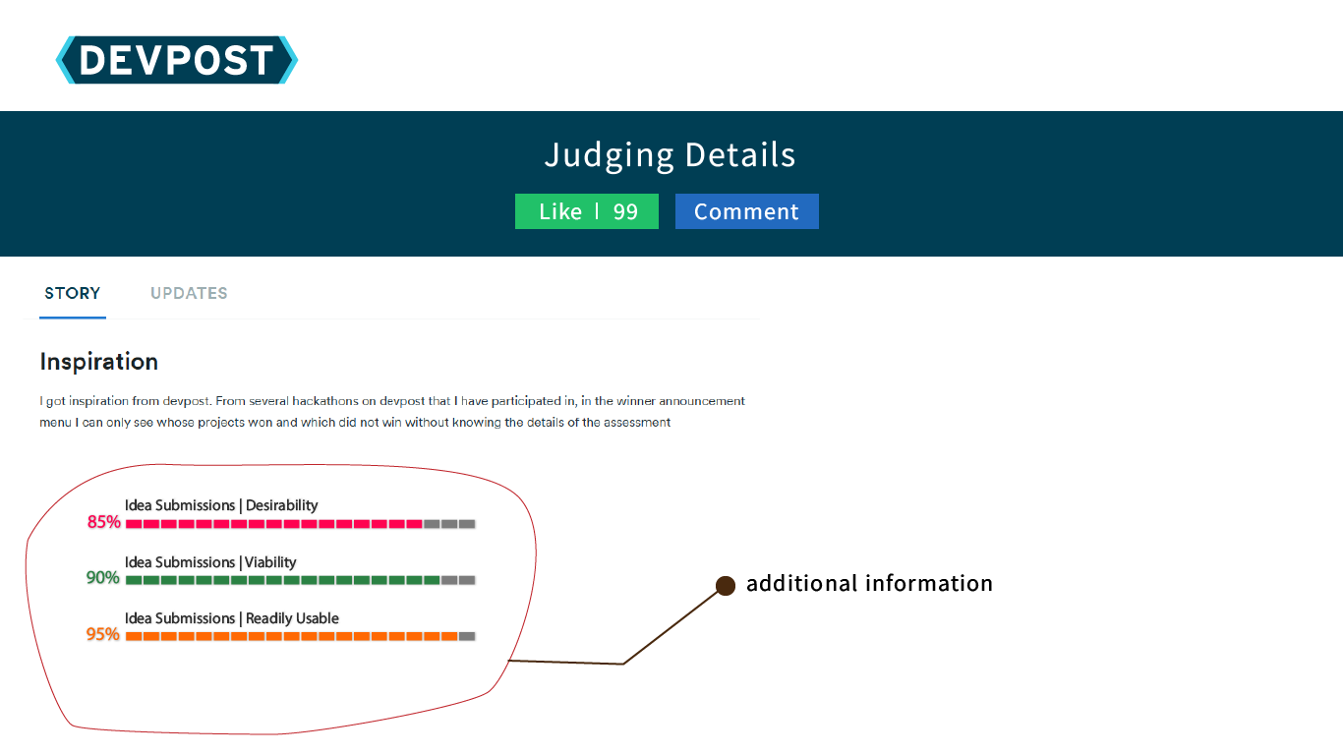
layout 3

